Slide 1
Word2Vec
http://arxiv.org/pdf/1301.3781.pdf

Slide 2
Vector Addition for words
Woman
King
Queen
Dimensions are typically 5—300
(2 shown)
Man

Slide 3
Where do these vectors come from?
Grab a large corpus of text
Train a neural network of word embeddings
Instead of words as categories, make word ‘features’
Train on the nearby works for ‘context’
When I got a piece of _____ as a present, I was disappointed
I’m sad today, feeling ______
The color of the sky is ______
______ was the first President

Slide 4
Word Embeddings-– One hot encoded
I am the professor, you are the student
I
am
the
professor
you
are
the
student
1 0 0 0 0 0 0
Our vocabulary can have millions of words, so for a non trivial example each vector is millions of zeros and a single ‘1’. How can we compress this to 50 or 300 dimensions?
0 1 0 0 0 0 0
0 0 1 0 0 0 0
0 0 0 1 0 0 0
0 0 0 0 1 0 0
0 0 0 0 0 1 0
0 0 1 0 0 0 0
0 0 0 0 0 0 1

Slide 5
Solution
Create word pairs based on ‘nearby’ words
Nearby can be 1-10 tokens away
Example window “2”: words within +/- 2 positions of the current word
I am the professor, you are the student.
(I, [am, the]
(am,[I, the professor)
(the, [I, am, professor, you])
(professor, [am, the, you, are])
Etc….

Slide 6
Math
One hot vector!!
Effectively select row ’v’
1 x V
V x D
Effectively select row ’v’
0
Non-zero

Slide 7
Skip-gram model (Fast)
1 x V
V x D
Word +2
Word +1
Word -1
Word -2

Slide 8
Skip-gram model (Fast)
1 x V
V x D
Word +2
Word +1
Word -1
Word -2
Input (ohe)
“Embedding Layer”
Hidden layer
Outputs (1 for each vocab word aka HUGE)

Slide 9
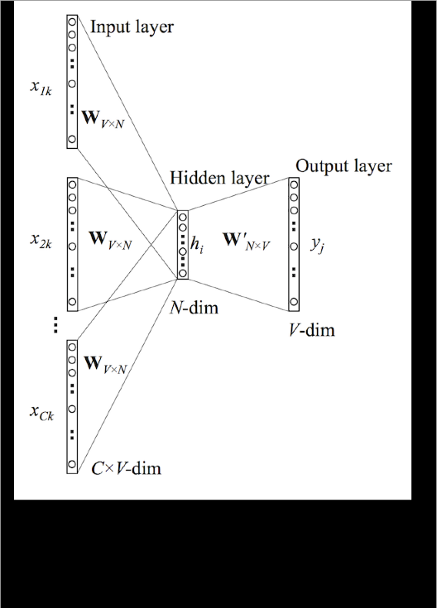
BOW Model (accurate)

Slide 10
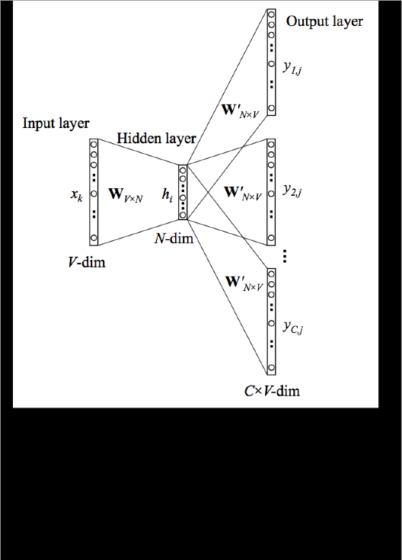
Both models are mirrors of each other (CBOW in same notation)

Slide 11
I HAVE BEEN LIED TOO!
Actually Word2Vec takes this further by adding a twist
Negative Sampling
Dot Product/Similarity
No negative samples: model will learn to only predict 1 (next slide)
What does this gain
SPEEEEEEEEEEEEEEEEEEEEEEEEED!
Sometimes BETTER is not FASTER
Language is huge: Sometimes we need speed over accuracy

Slide 12
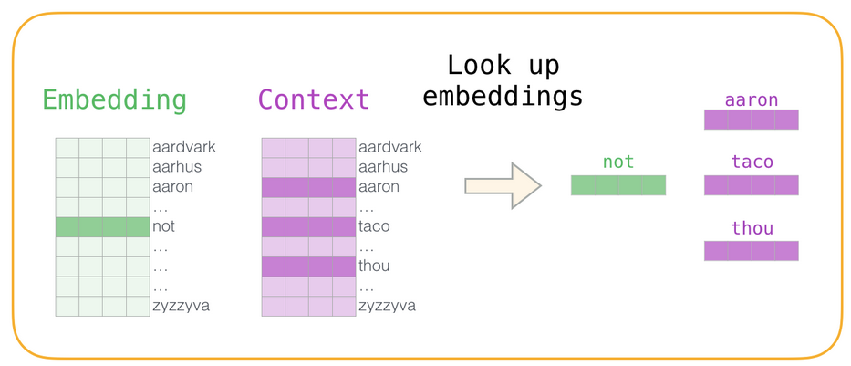
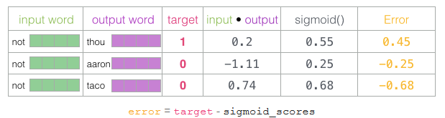
The twist

